Slide 1
Driver Behavior Detection

Slide 2

About us
Mahmoud Abdelnasser
Ahmed Alaa Elhousseny
Ahmed Alaa Fathy
Aliaa Ahmed Hassan
Rehab Ibrahim Ali

Slide 3
Agenda
1
Introduction
2
Data Preprocessing
3
ResNet
4
AlexNet
5
VGGNet
6
Deployment

Slide 4
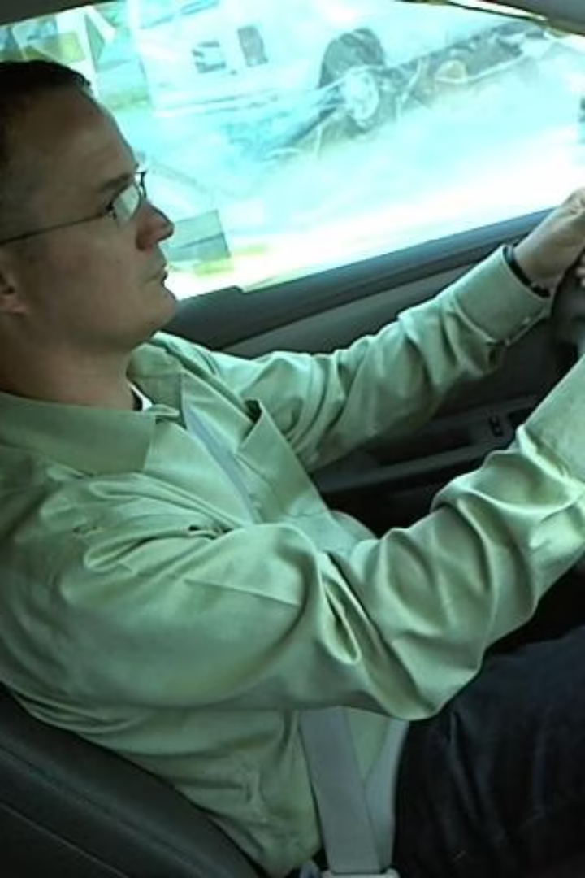
Introduction
In today's world, distracted driving is a leading cause of road accidents. Identifying unsafe behaviors like texting, talking on the phone, or other distractions can significantly enhance road safety. This project aims to build a deep learning model that classifies different driver behaviors in real-time using image data. By detecting these behaviors, we can contribute to reducing accidents and promoting safer driving practices.

Slide 5
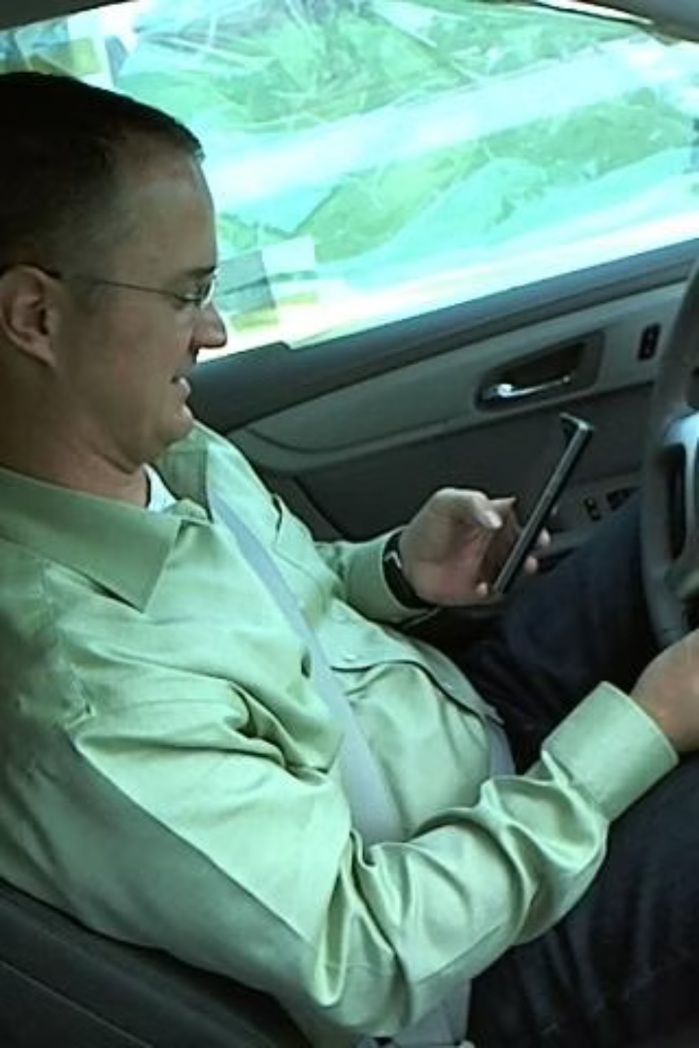
The Problem of Driver Distraction
1
Dangerous Distractions
2
Real-Time Monitoring
Driver distraction, such as texting or talking on the phone, poses a significant threat to road safety and can lead to devastating consequences.
Developing robust driver behavior detection models can enable real-time monitoring and intervention to promote safer driving practices.

Slide 6
Dataset Overview: Five Driver Behavior Classes
Safe Driving
Talking on Phone
Texting on Phone
Turning Others
Hands on the steering wheel, eyes on the road, and maintaining proper lane positioning.
Holding a phone to the ear while driving, often with a distracted gaze.
Actively engaging with a phone, with eyes diverted from the road.
Drivers making turns
around the wheel.

Slide 7
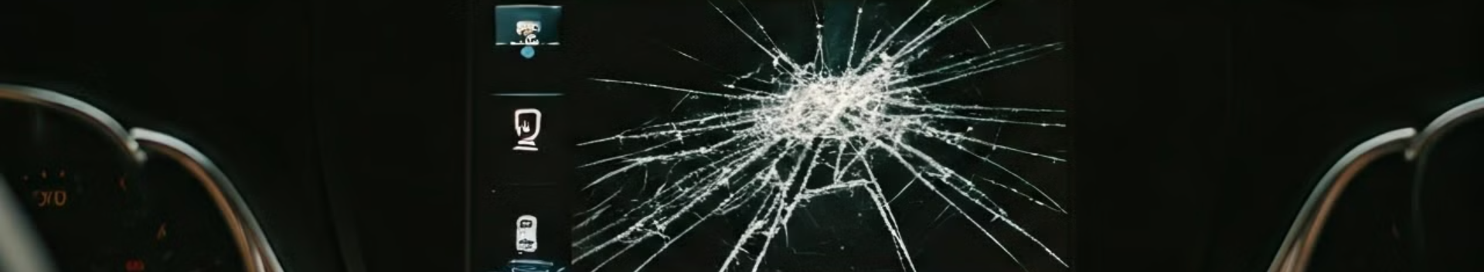
Data Cleaning: Removing Defective Images
Blurry Images
Incomplete Frames
Removing images with excessive blur that would hinder accurate behavior detection.
Discarding images where the driver's face or hands are not fully visible.
Reflections/Glare
Low Resolution
Eliminating images with significant reflections or glare that obscure key details.
Excluding low-resolution images that lack the necessary visual information.

Slide 8
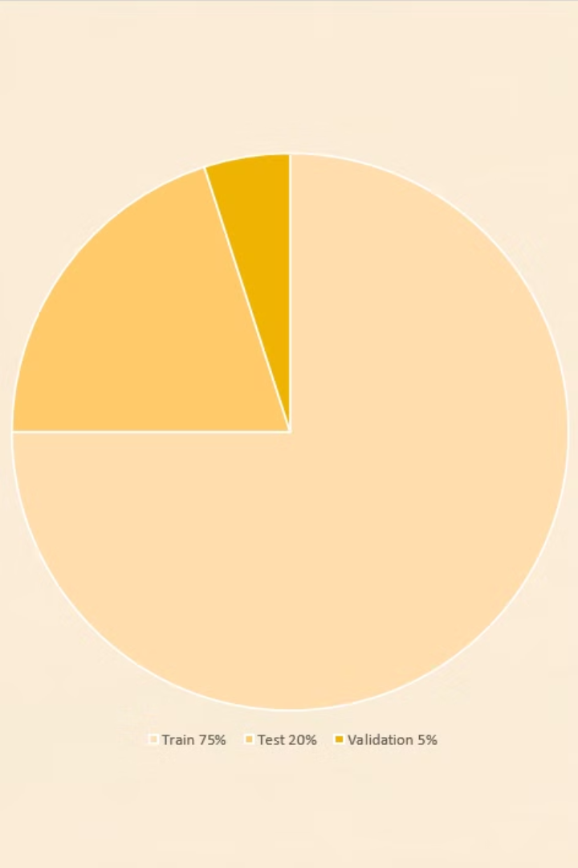
Data Splitting: Train, Test, and Validation Sets
1
Training Set
75% of the dataset for model training, to learn the underlying patterns.
2
Testing Set
20% of the dataset for evaluating the model's performance on unseen data.
3
Validation Set
5% of the dataset for monitoring the model's generalization during training.

Slide 9
Image Resizing:
Consistent Dimensions
Aspect Ratio Preservation
Image Rescaling
Resizing all images to a fixed size, such as 240×240 pixels, for model compatibility.
Maintaining the original aspect ratio to avoid distorting the visual information.
Scaling the pixel values to a 0-1 range to improve model stability.

Slide 10
Data Augmentation: Using ImageDataGenerator
Horizontal Flip
Rotation
Zoom
Randomly flipping images horizontally to increase dataset diversity.
Applying small random rotations to simulate natural head movements.
Slightly zooming in on images to introduce minor scale variations.

Slide 11
Model Training Preparation: Batch Generation with flow_from_dataframe
Batch Size
64
Train Set
Batches generated from 75% of the dataset
Test Set
Batches generated from 20% of the dataset
Validation Set
Batches generated from 5% of the dataset

Slide 12
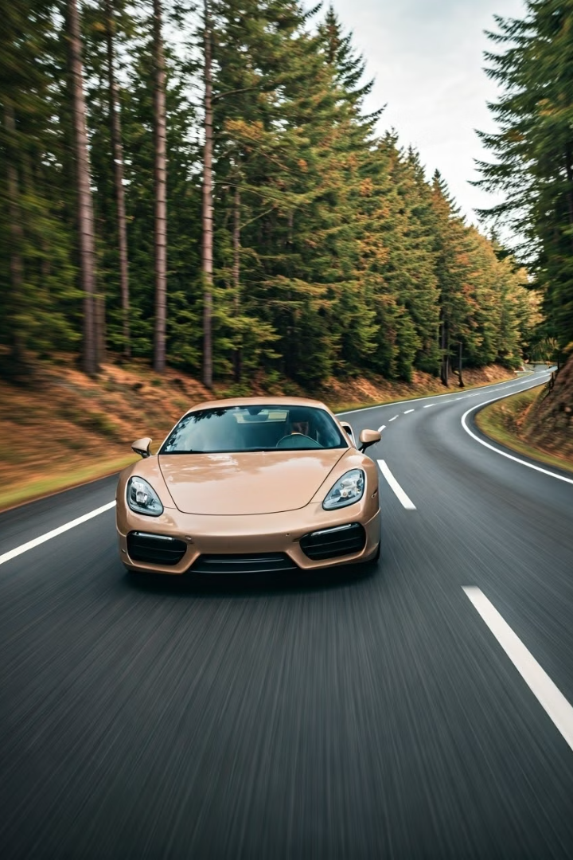
ResNet34 for Driver Behavior Detection
In this presentation, we will explore the ResNet34 architecture and its application in detecting driver behavior. ResNet, a deep neural network, addresses the vanishing gradient problem, enabling effective learning in very deep models.

Slide 13
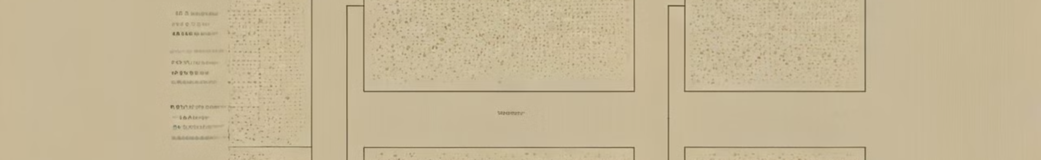
Understanding ResNet
Vanishing Gradient Problem
Effective Learning
Deep neural networks can suffer from the vanishing gradient problem, where gradients become increasingly small as they propagate through the network, hindering effective learning.
The skip connections in ResNet enable the network to learn more effectively, leading to improved performance on a variety of tasks, including driver behavior detection.
1
2
3
Skip Connections
ResNet introduces skip connections, which allow the network to bypass certain layers, mitigating the vanishing gradient issue and enabling the training of very deep models.

Slide 14
ResNet Architecture
Convolutional Layers
Batch Normalization
Max Pooling
The ResNet34 model consists of a series of convolutional layers that extract features from the input data.
Batch normalization is used to stabilize the training process and improve the model's performance.
MaxPooling is a down-sampling operation used in convolutional neural networks (CNNs) to reduce the spatial dimensions of feature maps while retaining the most important information.

Slide 15
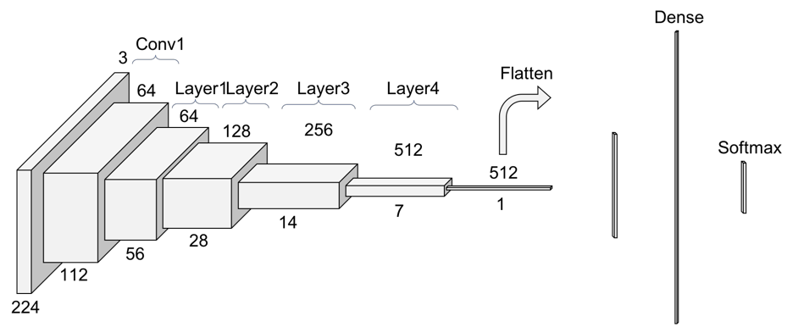

Slide 16
Training and Validation Accuracy
High Accuracy
Consistent Performance
Convergence
The ResNet34 model achieves impressive training and validation accuracy, demonstrating its ability to effectively detect driver behavior.
The model maintains a stable and consistent performance throughout the training process, indicating its robustness and generalization capabilities.
The training and validation accuracy curves converge, suggesting the model has learned the underlying patterns in the data effectively.

Slide 17
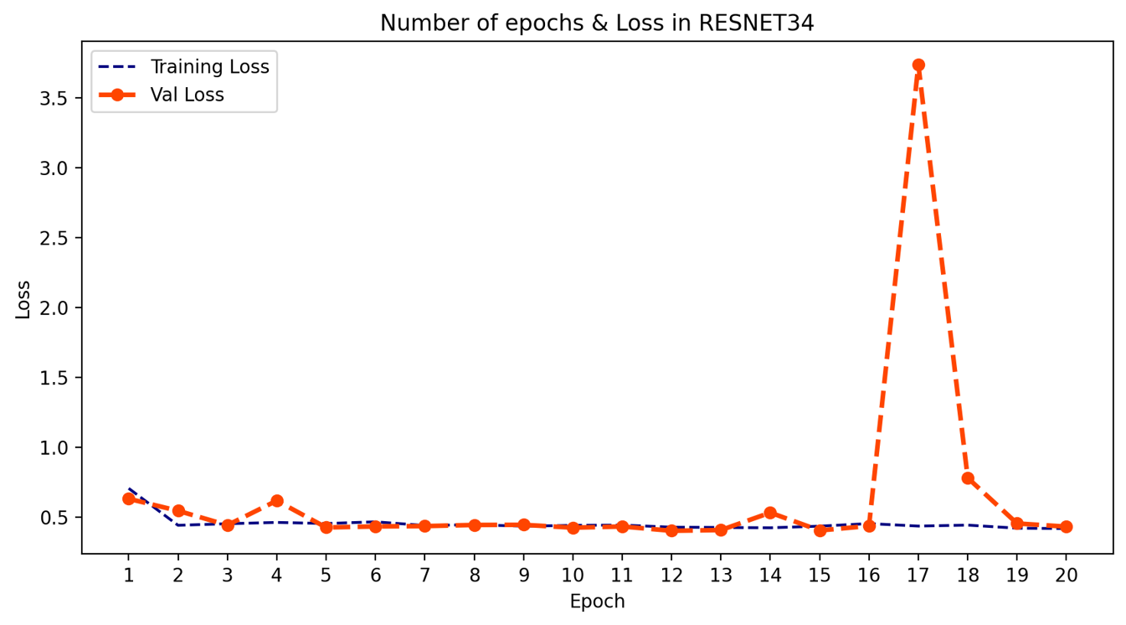
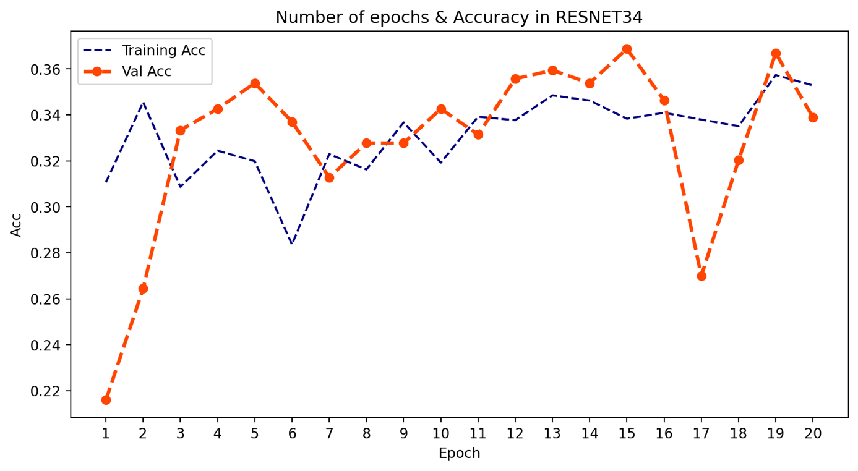
Loss and Accuracy Curves over 20 Epochs
For ResNet

Slide 18
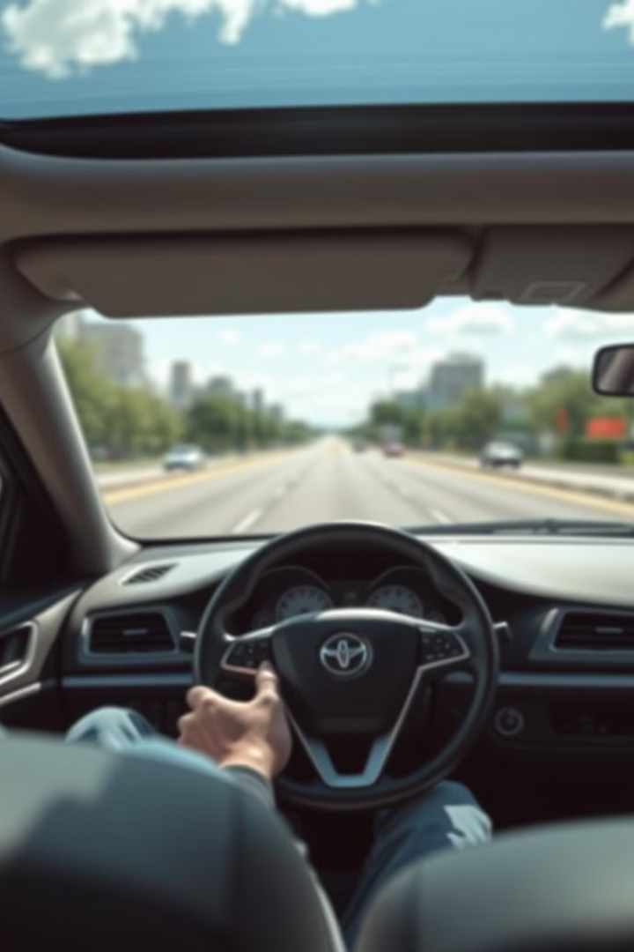
AlexNet for Driver Behavior Detection
AlexNet is a convolutional neural network (CNN) architecture that has been widely used for image classification tasks. In this context, we will explore how AlexNet can be applied to analyze driving behavior.

Slide 19

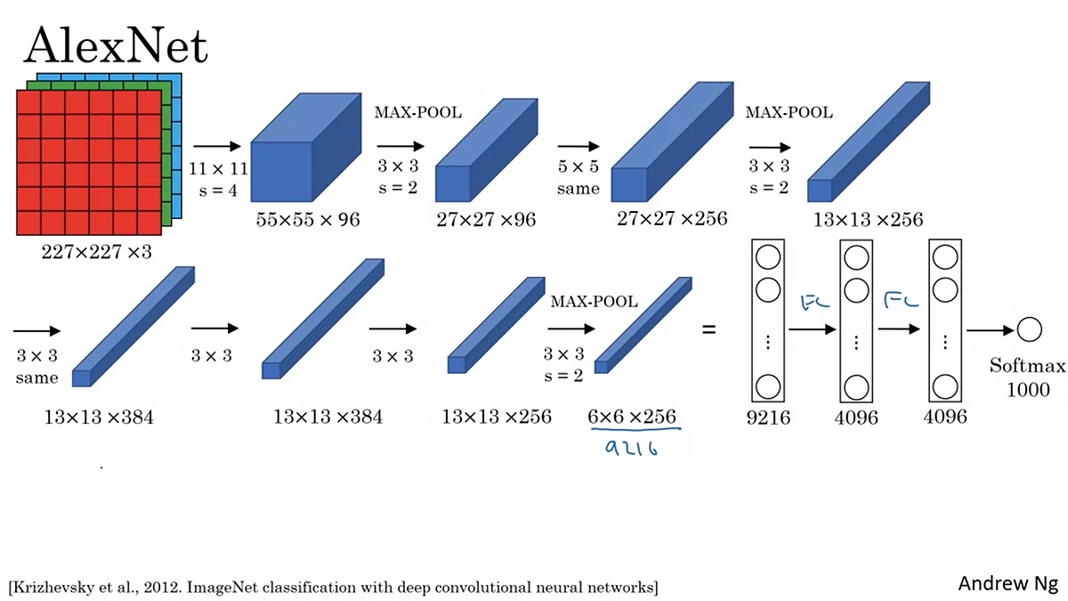
What is AlexNet?
1
Deep Learning Model
2
Image Classification
It excels at identifying objects within images, making it suitable for driver behavior analysis.
AlexNet is a pioneering CNN architecture that achieved breakthrough performance in image recognition.
3
Convolutional Layers
It leverages convolutional layers to extract features from images, learning patterns related to driver actions.

Slide 20
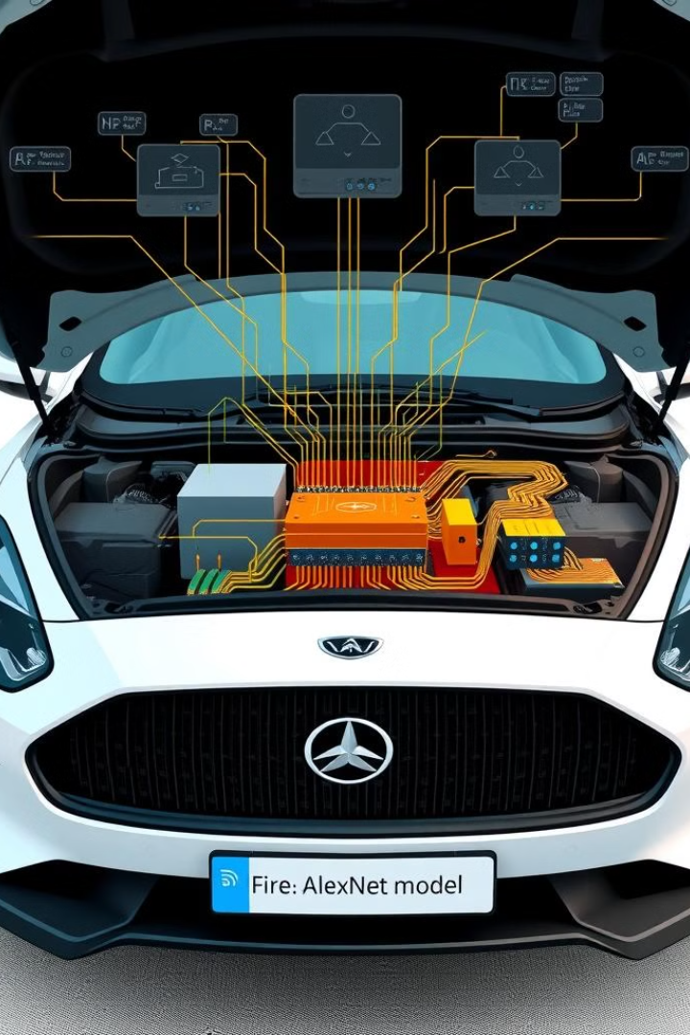
Why use AlexNet?
Accuracy
Efficiency
AlexNet has demonstrated high accuracy in image classification, crucial for reliable driver behavior detection.
It's relatively efficient in terms of computational resources and processing time, enabling real-time analysis.
Adaptability
AlexNet can be adapted and fine-tuned for specific driver behavior detection tasks, making it versatile.

Slide 21
Key features of AlexNet architecture
Convolutional Layers
Pooling Layers
Fully Connected Layers
Extract features by applying filters to input images, identifying patterns like lane markings, traffic lights, and other vehicles.
Reduce the dimensionality of feature maps, making the model more computationally efficient and reducing overfitting.
Combine extracted features into a final classification output, predicting driver behavior like lane changes, braking, or speeding.

Slide 22
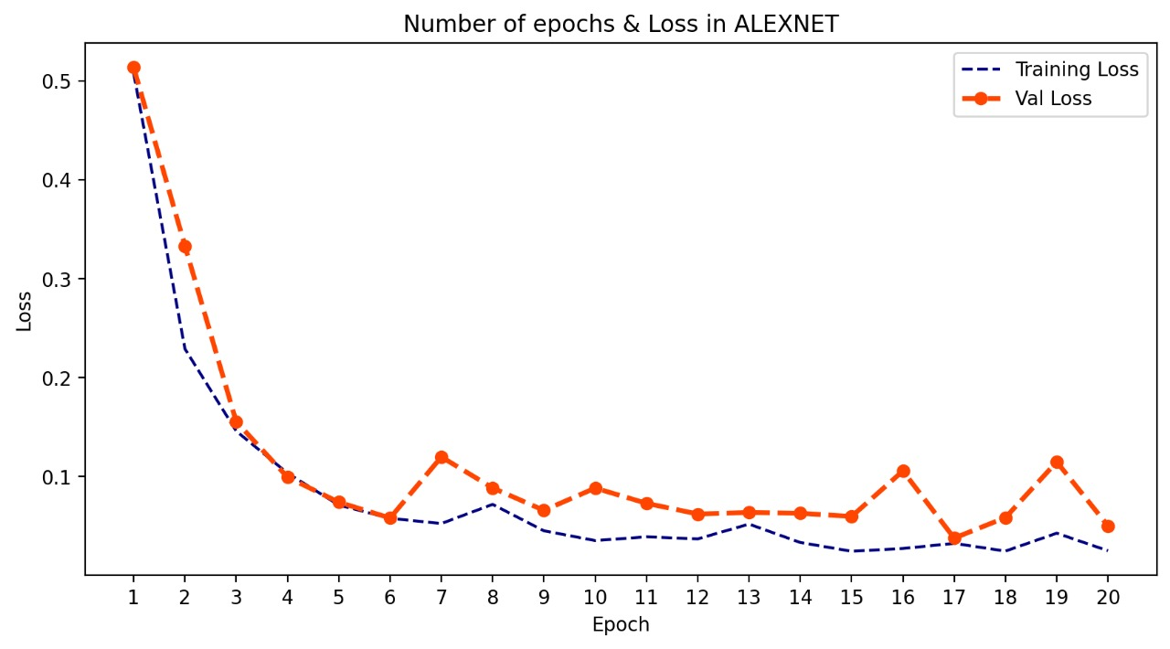
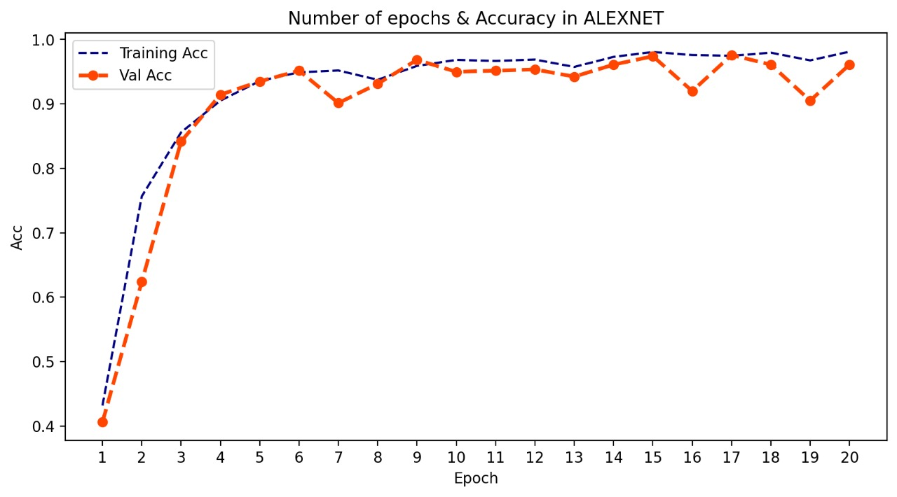
Loss and Accuracy Curves over 20 Epochs
For AlexNet

Slide 23
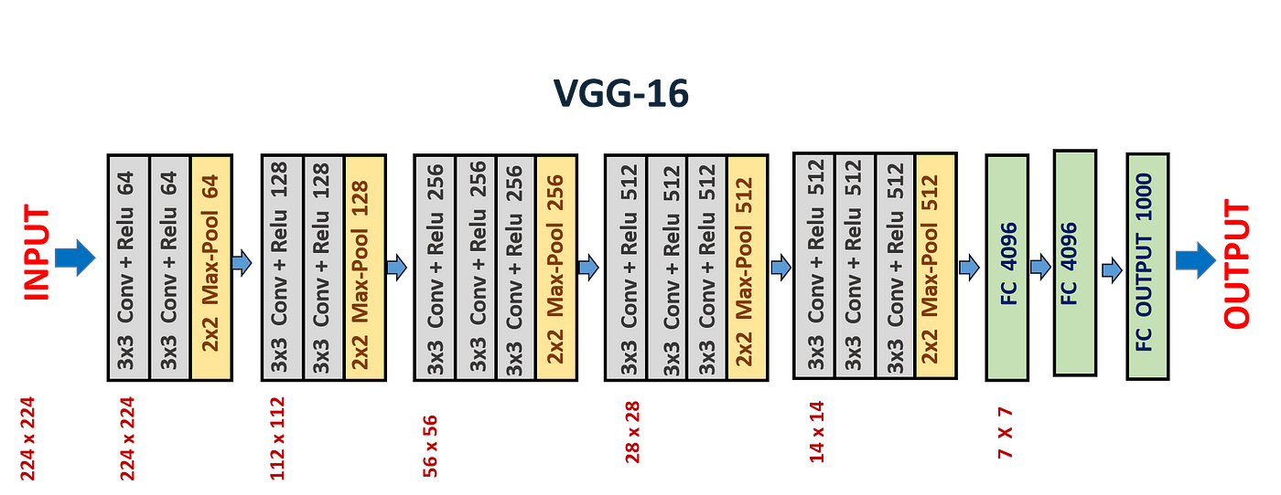
VGGNet for Driver Behavior Detection
VGG-16 is a convolutional neural network (CNN) that achieved state-of-the-art results in image classification in 2014. It's known for its simple yet effective architecture, using multiple layers of small 3x3 convolutional filters stacked on top of each other. This design allows for efficient feature extraction and robust classification.

Slide 24
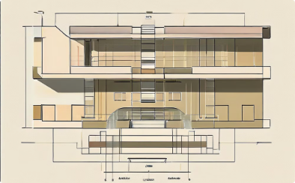
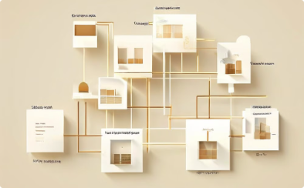


VGG Architecture
Input Layer
Convolutional Layers
Pooling Layers
Fully Connected Layers
The network accepts a 240x240 pixel image as input, typically in RGB format.
Multiple convolutional layers with 3x3 filters extract features from the image.
Max pooling layers reduce the spatial dimensions of feature maps, keeping the most important features.
The fully connected layers learn complex relationships between features and predict the class of the image.

Slide 25

VGG Benefits
1
Depth
2
Accuracy
The network's depth allows it to capture complex features, improving accuracy.
VGG achieved top-tier accuracy on image classification benchmarks, proving its effectiveness.
3
Simplicity
Deep CNN that uses 3x3 convolution filters stacked together with same padding.

Slide 26

Layers Explained
Convolutional Layers
1
Extract features using small 3x3 filters, capturing patterns like edges and textures.
2
Pooling Layers
Downsample feature maps, reducing size while preserving key information.
Fully Connected Layers
3
Learn complex relationships between features, leading to a final classification decision.

Slide 27
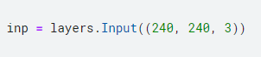
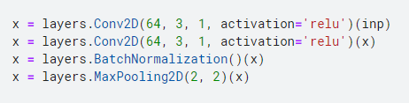
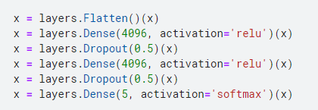
Key Code Snippets
Input Layer
Convolutional Layers
Dense Layers
Defines the input shape for the network, typically 224x224 pixel images.
Implements convolution operations using filters and activation functions like ReLU.
Fully connected layers that combine features and make the final classification.

Slide 28
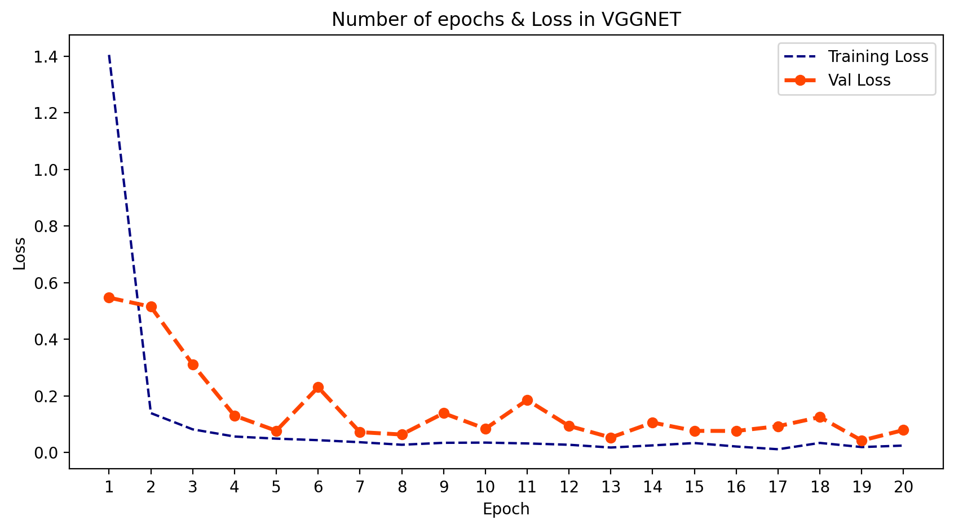
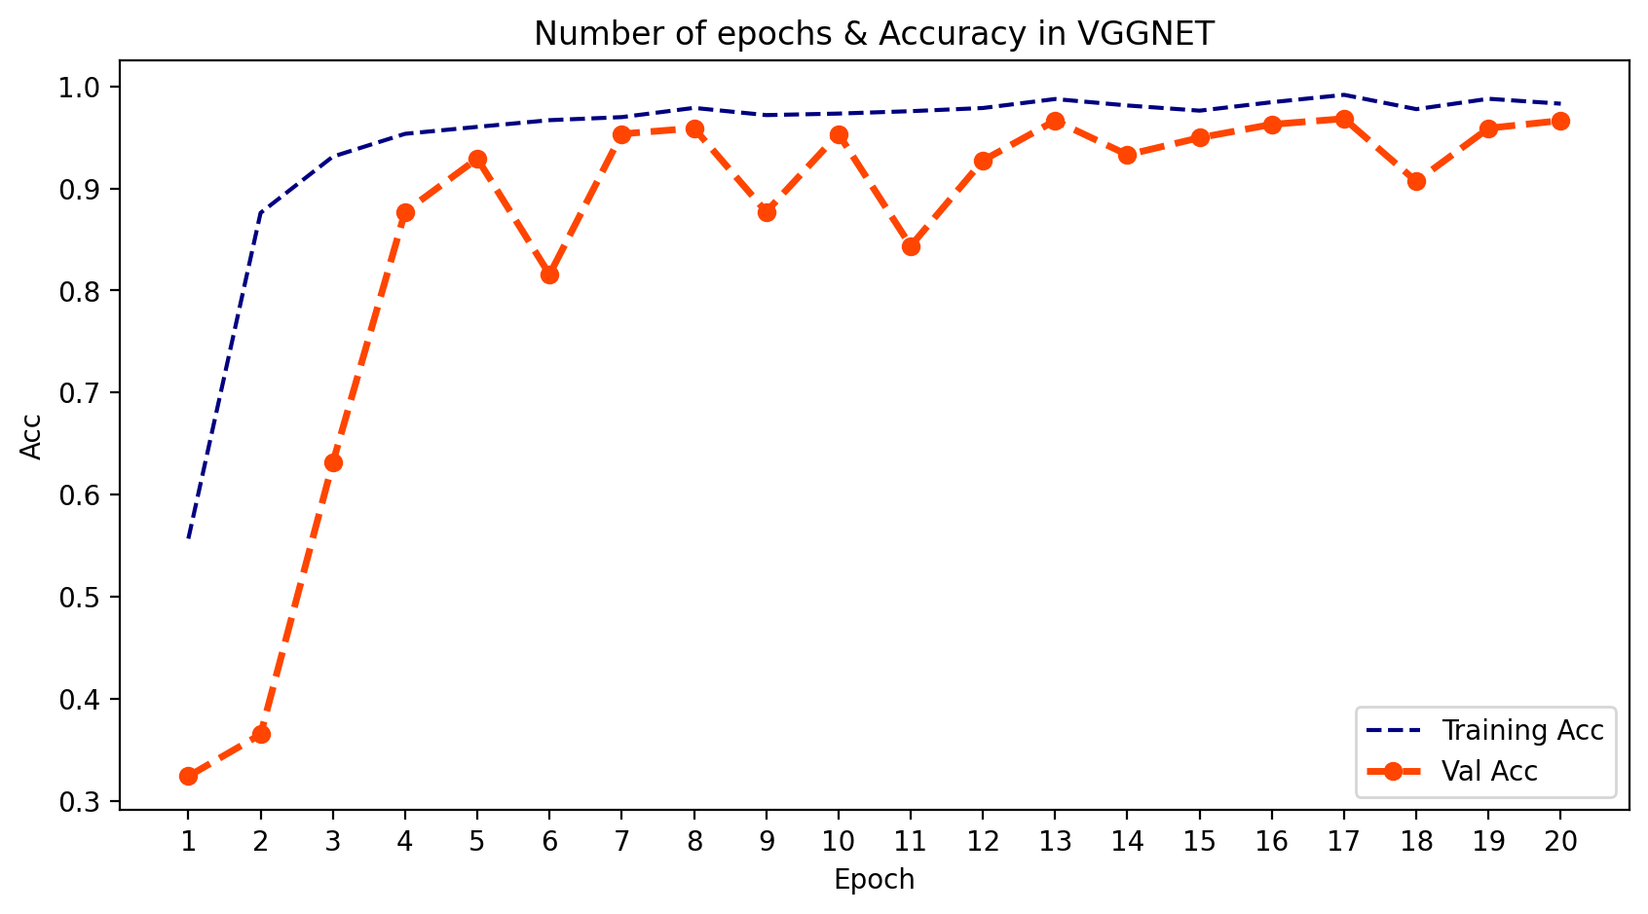
Training Results
Epoch
Loss
Accuracy
1
0.140
0.55
10
0.034
0.97
20
0.024
0.99

Slide 29

Deployment
Streamlit App
1
Interactive Interface
2
Real-Time Processing
The Streamlit app provides an intuitive, user-friendly interface for analyzing driver behavior.
Images are processed and analyzed in real-time, delivering immediate insights into driving activities.
3
Model Selection
Users can choose from pre-trained models like AlexNet, VGG, and ResNet for driver behavior prediction.

Slide 30
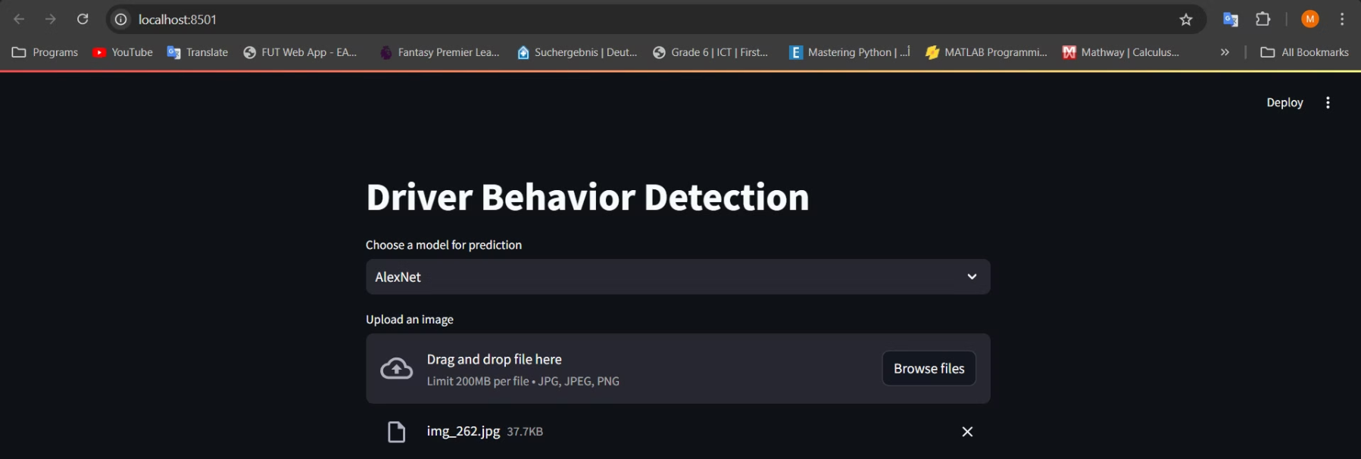



Real-World App Deployment
User Experience
The Streamlit app provides an intuitive interface for users to upload and analyze driving images.
Real-Time Detection
The app processes images in real-time, delivering immediate insights into driver behavior.
Model Flexibility
Users can select from various pre-trained models to suit their specific needs and preferences.

Slide 31
Image Processing and Normalization
Preprocessing
Optimization
Visual Feedback
The app preprocesses and normalizes uploaded images to ensure accurate input for the models.
Efficient image handling techniques are employed to maintain low latency and high throughput.
The app provides visual cues to guide users through the image submission and analysis process.

Slide 32



Effectiveness of Deployment
Improved Safety
Data-Driven Insights
Automated Monitoring
The app's ability to detect unsafe driving behaviors can help promote safer driving habits.
The app provides valuable data and analytics to understand driver behavior patterns.
The app automates the process of monitoring and analyzing driver behavior in real-time.

Slide 33
Questions?
THANK YOU!

